Slide 1
Front- and Back-Office Information Systems
Front-office information systems support business functions that extend out to the organization’s customers (or constituents).
  Marketing
  Sales
  Customer management
Back-office information systems support internal business operations of an organization, aw well as reach out to suppliers (of materials, equipment, supplies, and services).
  Human resources
  Financial management
  Manufacturing
  Inventory control
2-<number>
Notes:
Teaching Notes
This classification scheme comes from popular usage in the trade literature.
This terminology is not to be confused with office automation. In fact, office automation systems can be either front-office or back-office, just as with other types of information system applications.

Slide 2
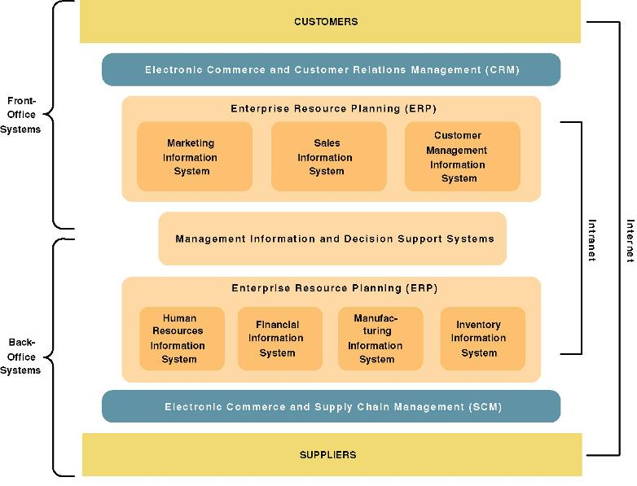
A Federation of Information Systems
2-<number>
Notes:
Teaching Notes
This slide visually illustrates front- and back-office applications and highlights the following:
Many organizations purchase their back-office systems in the form of enterprise resource planning (ERP) products such as SAP, PeopleSoft, and Oracle.
The ERP industry is trying to expand into the front-office applications.
It might be noted that electronic commerce and business extensions are being added to both front- and back-office applications in order to streamline interfaces to both customers and suppliers.
E-commerce is being driven by the Internet (and private extranets).
E-business is being enabled by intranets.

Slide 3
Information System Applications
  A transaction processing system (TPS) is an information system that captures and processes data about business transactions.
  A management information system (MIS) is an information system that provides for management-oriented reporting based on transaction processing and operations of the organization.
  A decision support system (DSS) is an information system that either helps to identify decision making opportunities or provides information to help make decisions.
2-<number>
Notes:
Conversion Notes
These definitions on this and the next slide were not in the 5th edition.
These definitions can be useful to help students understand what an information system is in all its varieties and flavors. Depending on the prerequisites of your course, you may want to cover these in more or less detail.

Slide 4
Information System Applications
  An Executive Information System (EIS) is an information system designed for top-level managers that integrates data from all over the organization into “at-a-glance” graphical indicators and controls.
  An expert system is an information system that captures the expertise of workers and then simulates that expertise to the benefit of nonexperts.
  A communications and collaboration system is an information system that enables more effective communications between workers, partners, customers, and suppliers to enhance their ability to collaborate.
  An office automation system is an information system that supports the wide range of business office activities that provide for improved work flow between workers.
2-<number>
Notes:
Teaching Notes
Some books treat DSS and EIS as distinct; however, if definitions are closely examined, the differences are subtle – they only differ in audience. Both DSS and EIS tend to support the same decision-oriented activities and basically work the same.

Slide 5
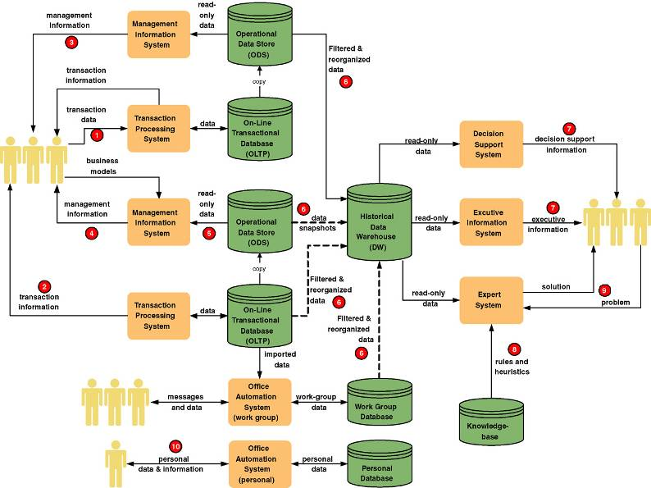
Information System Applications
2-<number>
Notes:
Teaching Notes
It may be useful to walk through this diagram in class. The textbook coverage included numbered annotations that highlight portions of this diagram.
Remind students that any given information system may include many instances of each of these IS application processes and databases.

Slide 6
Information Systems Architecture
Information systems architecture - a unifying framework into which various stakeholders with different perspectives can organize and view the fundamental building blocks of information systems.
2-<number>
Notes:
No additional notes

Slide 7
Focuses for Information Systems
Knowledge — the raw material used to create useful information. [I thought that was data!]
Process — the activities (including management) that carry out the mission of the business.
Communication — how the system interfaces with its users and other information systems.
2-<number>
Notes:
Conversion Notes
The KNOWLEDGE building block was called DATA in the 5th edition.
The PROCESS building block was called PROCESSES in the 5th edition.
The COMMUNICATION building block was called INTERFACES in the 5th edition.

Slide 8
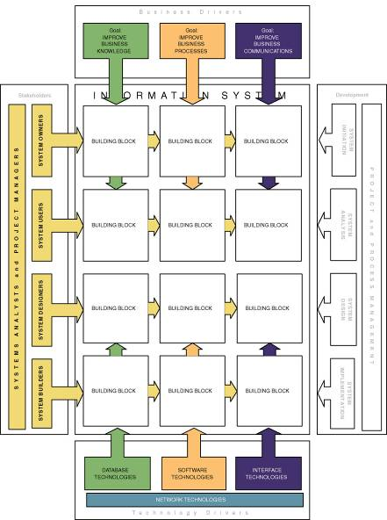
Information System Building Blocks
2-<number>
Notes:
Teaching Notes
This slide serves to establish the focus for the chapter. The highlighted cells are the information system building blocks that are described in detail as this chapter unfolds.

Slide 9
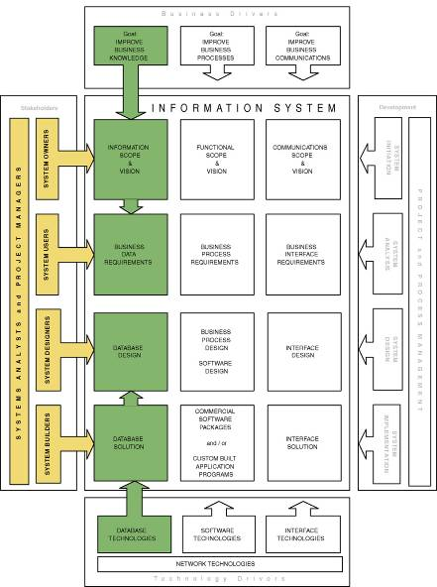
KNOWLEDGE Building Blocks
2-<number>
Notes:
Conversion Notes
The KNOWLEDGE building block was called DATA in the 5th edition.
Teaching Notes
This slide visually illustrates the chapter’s discussion of the KNOWLEDGE focus as seen by different stakeholders.
If your students have taken a database course, it can be useful to summarize that experience within the context of the KNOWLEDGE column.

Slide 10
Views of KNOWLEDGE
System owners’ view
  Interested not in raw data but in information that adds new business knowledge and information that help managers make intelligent decisions.
  Business entities and business rules.
  E.g.: www.uwgb.edu/research
System users’ view
  View data as something recorded on forms, stored in file cabinets, recorded in books and binders, organized into spreadsheets, or stored in computer files and databases.
  Tend to focus on the business issues as they pertain to the data.
  Data requirement – a representation of users’ data in terms of entities, attributes, relationships, and rules independent of data technology.
System designers’ view
  Data structures, database schemas, fields, indexes, and constraints of particular database management system (DBMS).
System builders’ view
  SQL
  DBMS or other data technologies
2-<number>
Notes:
Teaching Notes
This slide places definitions and key terms relevant to the KNOWLEDGE focus into the context of stakeholders.

Slide 11
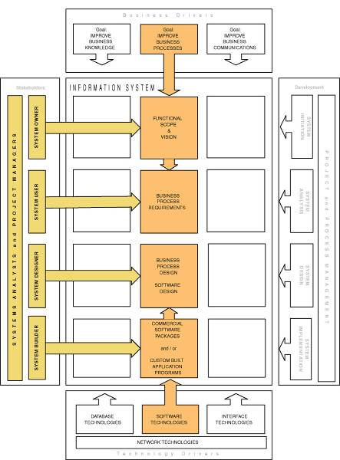
PROCESS Building Blocks
2-<number>
Notes:
Conversion Notes
The PROCESS building block was called PROCESSES in the 5th edition.
Teaching Notes
This slide visually illustrates the chapter’s discussion of the PROCESS focus as seen by the different stakeholders.
Most students have some programming experience. Accordingly, it can be useful to summarize that experience within the context of the PROCESS column. Consider summarizing that experience by working bottom-to-top in the column to reinforce their perspective of the “application programs” they wrote.
The programming instructor typically played the roles of system owners, users, and analysts when they wrote the programming assignments.
The student typically played the roles of designer (e.g., flowcharts) and builder (e.g, programming code).

Slide 12
Views of PROCESS
System owners’ view
  Concerned with high-level processes called business functions.
  Business function – a group of related processes that support the business. Functions can be decomposed into other subfunctions and eventually into processes that do specific tasks.
  A cross-functional information system – a system that supports relevant business processes from several business functions without regard to traditional organizational boundaries such as divisions, departments, centers, and offices.
  E.g.: ERP Systems, like PeopleSoft & SAP
Continued ...
2-<number>
Notes:
Teaching Notes
This slide places definitions and key terms relevant to the PROCESS focus into the context of stakeholders.

Slide 13
Views of PROCESS (continued)
System users’ view
Concerned with work that must be performed to provide the appropriate responses to business events.
Business processes – activities that respond to business events.
E.g., Registration: Late add or drop.
Process requirements – a user’s expectation of the processing requirements for a business process and its information systems.
Policy – a set of rules that govern a business process.: Approvals
Procedure – a step-by-step set of instructions and logic for accomplishing a business process. Is it documented real well? E.g.: Late Add?
Work flow – the flow of transactions through business processes to ensure appropriate checks and approvals are implemented.
Wouldn’t it be nice if we could digitally sign documents and route them electronically, guided by the system, and send Email notifications when “it’s your turn”, and when “it’s complete”?
Continued ...
2-<number>
Notes:
Teaching Notes
This slide places definitions and key terms relevant to the PROCESS focus into the context of stakeholders.

Slide 14
Views of PROCESS (continued)
System designers’ view
  Concerned with which processes to automate and how to automate them
  Constrained by limitations of application development technologies being used
  Software specifications – the technical design of business processes to be automated or supported by computer programs to be written by system builders.
System builders’ view
  Concerned with programming logic that implements automated processes
  Application program – a language-based, machine-readable representation of what a software process is supposed to do, or how a software process is supposed to accomplish its task.
  Prototyping – a technique for quickly building a functioning, but incomplete model of the information system using rapid application development tools.
2-<number>
Notes:
Teaching Notes
This slide places definitions and key terms relevant to the PROCESS focus into the context of stakeholders.

Slide 15
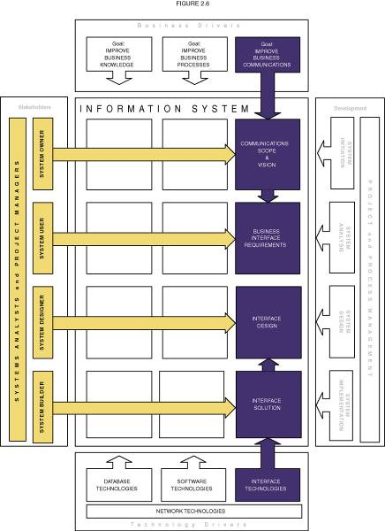
COMMUNICATION Building Blocks
2-<number>
Notes:
Conversion Notes
The COMMUNICATION building block was called INTERFACE in the 5th edition.
Teaching Notes
This slide visually illustrates the chapter’s discussion of the COMMUNICATION focus as seen by the different stakeholders.
Many students have written programs for graphical user interfaces using languages such as Access, Visual Basic and HTML. Accordingly, it can be useful to summarize that experience within the context of the INTERFACE column.
While it is conceptually and practically useful to separate COMMUNICATION and PROCESS, it should be noted that many of today’s contemporary application development environments (ADEs) such as .NET effectively integrate the technology used to construct both the user interface and the application logic. Some students find this confusing.
Interestingly, the emphasis on Web-based applications is truly separating the concerns. For example, the interface elements of a Web are written in HTML while the application logic is written in C++ or Java.

Slide 16
Views of COMMUNICATION
System owners’ view
  Concerned with communications scope of an information system.
    Who (which business units, employees, customers, and partners) must interact with the system?
    Where are these business units, employees, customers, and partners located?
    What other information systems will the system have to interface with?
System users’ view
  Concerned with the information system’s inputs and outputs.
Continued ...
2-<number>
Notes:
Teaching Notes
This slide places definitions and key terms relevant to the COMMUNICATION focus into the context of stakeholders.

Slide 17
Views of COMMUNICATION (continued)
System designers’ view
  Concerned with the technical design of both the user and the system-to-system communication interfaces.
  Interface specifications – technical designs that document how system users are to interact with a system and how a system interacts with other systems.
  User dialogue – a specification of how the user moves from window to window or page to page, interacting with the application programs to perform useful work.
System builders’ view
  Concerned with the construction, installation, testing and implementation of user and system-to-system interface solutions.
  Middleware – utility software that allows application software and systems software that utilize differing technologies to interoperate.
2-<number>
Notes:
Teaching Notes
This slide places definitions and key terms relevant to the COMMUNICATION focus into the context of stakeholders.

Slide 18
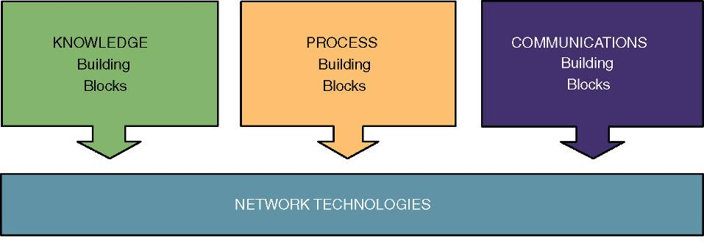
Network Technologies and the IS Building Blocks
2-<number>
Notes:
Teaching Notes
This slide illustrates the classic model of separating and partitioning the layers of an information system application across a network.
This clean-layering approach allows any one building block to be replaced with another while having little or no impact on the other building blocks.
This is called a distributed computing architecture and it can be implemented using either client/server or Internet/intranet technology, or a combination of both.

